Slide 1
AP Updates and TIPS
2020 APGOPO Exam

Slide 2
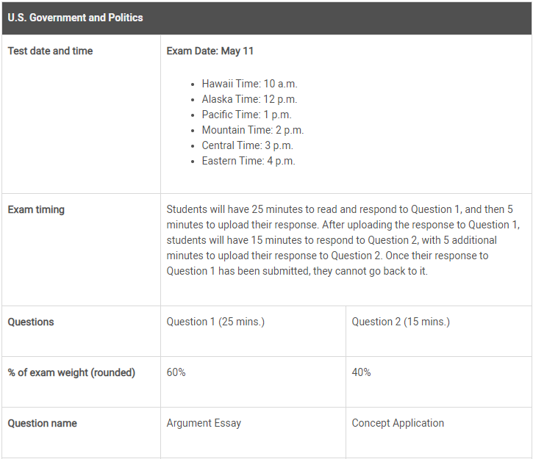
UPDATES
You MUST take the exam on May 11th at 4:00PM and can only make up if there are technology issues
NOTE: times are shorter than original
ONLY Argumentative and Conceptual FRQ

Slide 3
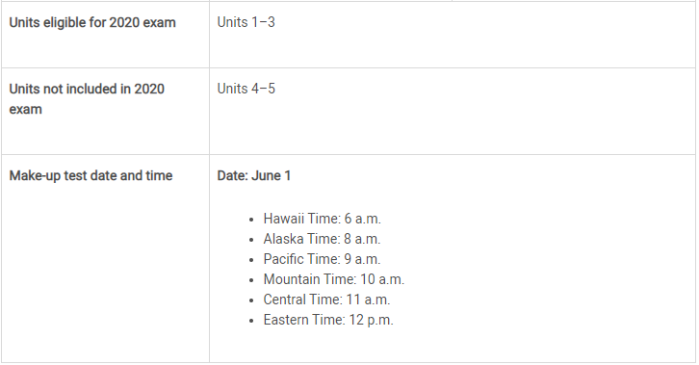
UPDATES
2020 Exam only consists of Unit 1-3:
Module 1: Foundations
Module 4: Institutions (Branches)
Module 5: Bureaucracy
Module 6: Civil Rights and Liberties
https://apcoronavirusupdates.collegeboard.org/students
(Links to an external site.)

Slide 4
Testing Method
You can take the exam on phone OR computer. Submissions will be either:
typed on a computer
Window 1 = prompt/clock (a timer will be set on the screen, with 5 minutes upload time included, and that last 5 minutes will show an “upload warning”)
Window 2 = response.
Can also type up a Word doc, Google Doc, and then upload
or handwritten, then photographed and uploaded on a phone
Note: test responses must be uploaded from the same device the question is accessed from
Once response to first question is uploaded, the second prompt will automatically load
Open book test means you CAN use your notes, books, printouts
Students will do their best if they already know the content (limited amount of time)
CB is most concerned with application of the content, than the content itself (content still cannot be incorrect).
Does NOT mean you can copy and paste, EVERYTHING must be in your own words
TIPS on taking an open note exam

Slide 5
Testing Security
Students will receive a “ticket” via email, to be automatically admitted to the May exam date -- (also in College Board account)available about 48 hours before -- if not used CB will send one for the June date
On test day, students should come to the online “testing room” 15-30 minutes early, so they can fill out a form that will help to prevent cheating.
At the start time, students will be admitted in “waves”, and a timer will tell them when the test prompt will appear (their response timer won’t begin until then)
Students are not allowed to seek help from others
Technology and tools to detect impersonation and collaboration will
be in place, consequences will be severe
Students who cheat (or conspire to cheat between now and
the test) will have that noted on all of their test results
when they're sent to colleges
Teachers will receive copies of your exams, which enable us to ensure that it matches your skill, ability, and handwriting
College Board Specific: https://apcoronavirusupdates.collegeboard.org/students/taking-ap-exams/security

Slide 6
Other Helpful Information
CB is assuring teachers that they will make sure that this year’s exam will be psychometrically balanced with all prior years’ exams, such that this year’s scores will reflect that they exam is “equally easy/hard” compared to previous years
CB stressing the exam is NOT “curved”, there are no quotas for all five exam scores, that it’s entirely possible for every student to earn a 3 or above.
Exam scores will still be ready by early July (they’re intending) -- no more than two weeks delay, if there’ll be any at all

Slide 8
Argumentative Essay FRQ Format | 25 min | 60% of Exam
Question: Essay prompt will have students make an argument and provide evidence to support their claim.
Tasks:
Choose ONE “side” to argue
Justify with a line of reasoning that will be used throughout the essay (thesis)
Pick and explain at least ONE evidence from the list provided and connect to thesis
Pick and explain another evidence (from list or your own) and connect to thesis

Slide 9
Argumentative Thesis (1pt)
Thesis (1pt)
Choose ONE argument and follow throughout
Be CLEAR (no shoulds, I believes etc.)
DO NOT repeat the prompt (no points if you do this)
Have line of reasoning that you will use throughout your entire essay (Argument + because)
Have a road map for both evidences (do not have to name but briefly mention)
Best you can do without a thesis is 2 points!!
PRESIDENT
War is not a time for gridlock, but rather a time for quick and effective leadership. Through the powers given to the President in the Constitution and the views of the executive, it is clear the founding fathers wanted the president to have more power during times of war to make swift and successful decisions that can not be made by a large group of people like Congress.
CONGRESS
Leading a country through war is not an easy task, and should not be left to the devices of one person. Through their powers in the Constitution and ability to check the president, Congress ultimately has more power during war, in order to ensure that the decisions being made, are in the citizens’ best interest.
OR
Notes:
Link to graphic organizer: https://docs.google.com/drawings/d/1gX_FTwoaZgi1DfqiCQ5XvXJ75q1h1nPDb-_kMQRavbc/edit?usp=sharing

Slide 10
Argumentative Evidence (4pts)
Evidence (1-2pts)
Choose at least ONE from the list and choose another from list or knowledge
SUGGESTION: choose both from list- it says you can pick one from list and one other, but it is SAFEST to just pick two from what they give you!
Mention them by name; can quote (no points for quote)
Evidence Summary (1-2pts)
Summarize in your own words (be very careful- anything that sounds/looks like plagiarism will be flagged)
Make clear you understand what the document is
Connect specifically to topic in prompt (you cannot use just anything in the Constitution, it must make sense to topic- EX: you could not talk about the President’s power to veto in this example or Congress’ power to tax)
PRESIDENT
Constitution- Article II grants the President power of Commander and Chief which allows them to use the military as they see fit during times of war.
Federalist #70- Hamilton stressed the need for a strong executive leader, especially in crisis (war)
CONGRESS
Constitution- Article I grants Congress the power to declare war which allows them to control when the country goes into a foreign conflict.
War Powers Act- limited powers of the President during times of war by requiring Congress be notified of presidential military actions done in an area that war has not been declared
Notes:
Link to graphic organizer: https://docs.google.com/drawings/d/1gX_FTwoaZgi1DfqiCQ5XvXJ75q1h1nPDb-_kMQRavbc/edit?usp=sharing

Slide 11
Argumentative Reasoning (2pts)
Evidence Reasoning (1-2pts)
Different than summary
CONNECT to thesis (WHY does it support your answer- be specific and clear)
End each evidence by restating thesis to help prove point
Conclusion
Does NOT give you an extra point, however, if you MISS the thesis, you can get credit for a thesis from this!!
PRESIDENT
Constitution- Having only the President in charge of the military, allows them to be more efficient in making decisions during times of war. Too many people in charge, would put the country at risk of not being able to respond to immediate threats. With the power given by the Constitution, the President can act immediately when it is necessary, providing the country with strength and security.
Federalist #70- Hamilton understood the need for our country to have respect abroad. If the power of war lied in the hands of Congress, the gridlock and partisanship would slow the decision process to a detrimental pace, risking allies and giving the world a negative view of the nation. Because the President has more power in war, they are able to make unilateral decisions in times of crisis, creating stability and respect.
CONGRESS
Constitution- It is clear that the founding fathers did not want the power of war to be held in the hands of one person, but rather many. If war is not declared, the President is restricted in how they can use troops, leaving the power to Congress. By giving Congress more power in war, the Constitution guarantees that if the country goes into a conflict, that conflict is absolutely necessary.
War Powers Act- Ultimately Congress has the most power, because they are able to declare war. Congress needs to step in and make sure the President does not abuse their power within those realms. By requiring Congressional approval for the military to enter a conflict, Congress is able to check the President’s power and ensure the best decision for the nation.
Notes:
Link to graphic organizer: https://docs.google.com/drawings/d/1gX_FTwoaZgi1DfqiCQ5XvXJ75q1h1nPDb-_kMQRavbc/edit?usp=sharing

Slide 12
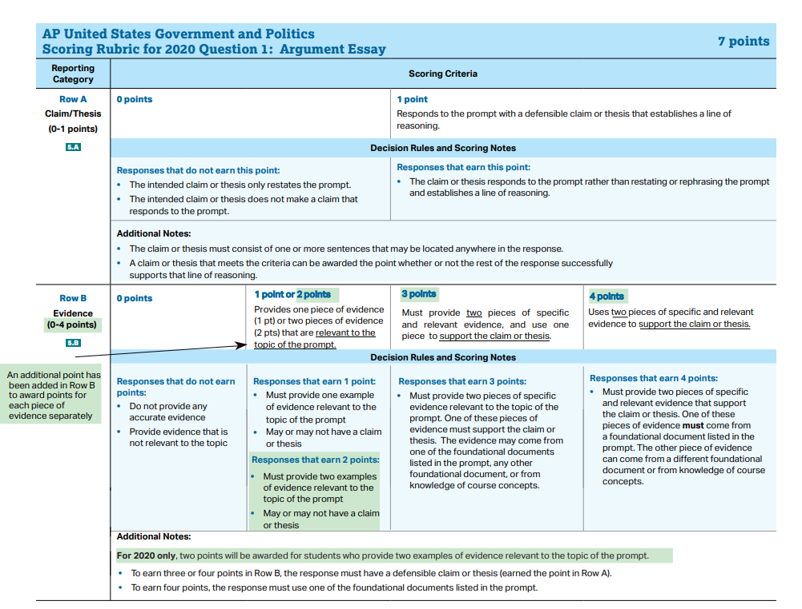
Argumentative FRQ Rubric
7 points total!
DO NOT RESTATE THE PROMPT
MUST CONNECT TO TOPIC
MUST summarize (in your own words) the document to prove that it connects to thesis
CANNOT get point 3 or 4 WITHOUT a thesis

Slide 13
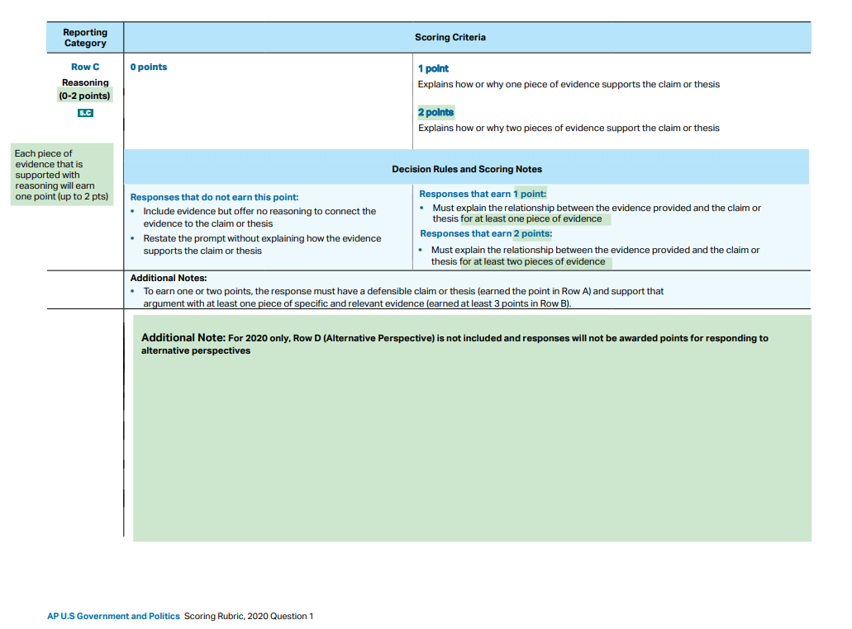
Argumentative FRQ Rubric
Must then EXPLAIN why the document supports your claim (make sure to restate your thesis
Must have thesis to get points
Must have appropriate documents to get points
NOTE: NO ALT PERSPECTIVE

Slide 14
Argumentative FRQ Required Documents
The Declaration of Independence
Document
Video analysis
The Articles of Confederation
Document
Video analysis
The Constitution of the United States
Document
PDF-Provides explanations next to each section
Video analysis
FEDERALIST NO.10
Document
Video analysis
Brutus NO. 1 (Anti-Federalist
Document
Video analysis
Federalist No.51
Document
Video analysis
Federalist No.70
Document
Video analysis
Federalist No.78
Document
Video analysis-Paper; Article III
"Letter from a Birmingham Jail" (By MLK)
Document
Video analysis
HELPFUL DOCUMENT (all docs):
https://docs.google.com/document/d/1zxn7a20RmiqxkQXgx1c_F7NUVirQmEDHwDtn0cwLRAA/edit?usp=sharing

Slide 15
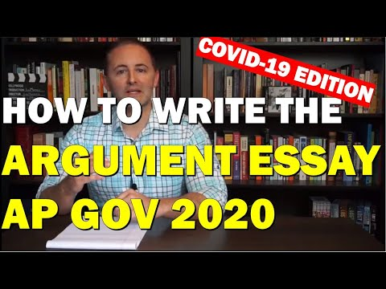

Slide 16
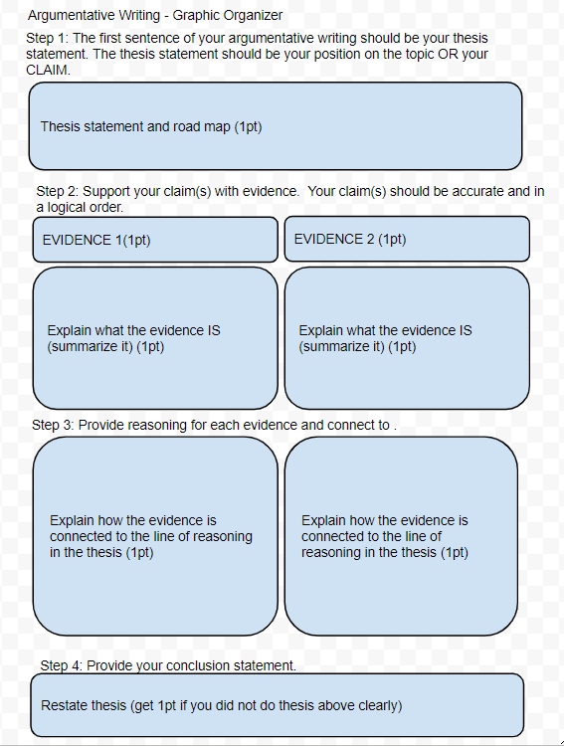
Graphic Organizer
Here is a link to the graphic organizer:
https://docs.google.com/drawings/d/1gX_FTwoaZgi1DfqiCQ5XvXJ75q1h1nPDb-_kMQRavbc/edit?usp=sharing

Slide 17
Argumentative Practice FRQ- Unit 1
The framers believed that a constitution was necessary to create a stable political system that would protect individual rights. However, understanding the need for political change, they included a process to amend the constitution. Develop an argument that takes a position on whether the process to amend the United States Constitution should be simplified.
Use at least one piece of evidence from one of the following foundational documents:
The Federalist 10
Brutus 1
Article V of the United States Constitution
In your essay, you must:
✓ Respond to the prompt with a defensible claim or thesis that establishes a line of reasoning.
✓ Support your claim with at least TWO pieces of specific and relevant evidence.
One piece of evidence must come from one of the foundational documents listed above.
A second piece of evidence can come from any other foundational document not used as your first piece of evidence, or it may be from your knowledge of course concepts.

Slide 18
Argumentative Practice FRQ- Unit 1
The United States Constitution establishes a federal system of government. Under federalism, policy making is shared between national and state governments. Over time, the powers of the national government have increased relative to those of the state governments.
Develop an argument about whether the expanded powers of the national government benefits or hinders policy making.
Use at least one piece of evidence from one of the following foundational documents:
The Articles of Confederation
Brutus 1
The Federalist 10
A second piece of evidence can come from any other foundational document not used as your first piece of evidence, or it may be from your knowledge of course concepts.

Slide 19
Argumentative Practice FRQ- Unit 1
The federal government can share revenue with state governments through grants. Some grants, such as categorical grants, place constraints on how the states are allowed to spend the money. Other types of grants, such as block grants, allow the states greater authority to determine how the money is spent.
Develop an argument that takes a position on which type of grant best serves the interests of citizens.
Use at least one piece of evidence from one of the following foundational documents:
Brutus 1
The Federalist 51
The Tenth Amendment of the United States Constitution
In your essay, you must:
✓ Respond to the prompt with a defensible claim or thesis that establishes a line of reasoning.
✓ Support your claim with at least one piece of specific and relevant evidence from one of the foundational documents listed above.

Slide 20
Argumentative Practice FRQ- Unit 1&2
As part of the blueprint for checks and balances, the United States Constitution outlines a procedure for Congress to impeach and remove public officials, including the president of the United States. Develop an argument on whether the congressional procedure outlined in the Constitution for impeachment and removal is an effective check on the president, too weak a check on the president, or too strong a check on the president.
Use at least one piece of evidence from one of the following foundational documents:
Brutus 1
The Federalist 51
The Federalist 70
A second piece of evidence can come from any other foundational document not used as your first piece of evidence, or it may be from your knowledge of course concepts.

Slide 21
Argumentative Practice FRQ- Unit 2
The founding fathers created a complicated system in which power was divided among multiple sources. Develop an argument that explain whether the President or Congress have more power during war in terms of national security and Constitutional ability.
In your essay, you must:
✓ Articulate a defensible claim or thesis that responds to the prompt and establishes a line of reasoning.
✓ Support your claim with at least TWO pieces of accurate and relevant information.
• At least ONE piece of evidence must be from the list below.
o Constitution
o Federalist 70
o War Powers Act
• The second piece of evidence must be from a different source on the list above OR from your knowledge of Congress or the Presidency.

Slide 22
Argumentative Practice FRQ- Unit 2&3
Equality of opportunity is a central value in the American political system. Choose either Congress or the Supreme Court, and present an argument for why your choice is most responsible for advancing the principle of equality of opportunity in the United States.
In your essay, you must:
✓ Articulate a defensible claim or thesis that responds to the prompt and establishes a line of reasoning.
✓ Support your claim with at least TWO pieces of accurate and relevant information.
At least ONE piece of evidence must be from the list below.
Fourteenth Amendment
Article I of the United States Constitution
The Federalist 78
A second piece of evidence must be from any other foundational document not used as your first piece of evidence or it may be from your knowledge of course concepts.

Slide 23
Argumentative Practice FRQ- Unit 3
Develop an argument that explain whether hate speech is protected by the Constitution.
In your essay, you must:
✓ Articulate a defensible claim or thesis that responds to the prompt and establishes a line of reasoning.
✓ Support your claim with at least TWO pieces of accurate and relevant information.
At least ONE piece of evidence must be from the list below. o Constitutional Amendments o Federalist #10
o Schneck v. United States
• The second piece of evidence must be from a different source on the list above OR from your knowledge of protected speech.

Slide 24
Conceptual FRQ Format | 15 min | 40% of Exam
Question: Short paragraph outlining a specific scenario which generally involves a conflict within a political institution.
Tasks:
-Respond to each of the three sections of the prompt
- Pay attention to the verbs (Explain, Describe, Identify) used in the prompt (the focus this year will be on explaining how concepts are inter-related rather than simply identifying and describing)
- Make sure your response addresses the entire prompt!!

Slide 25
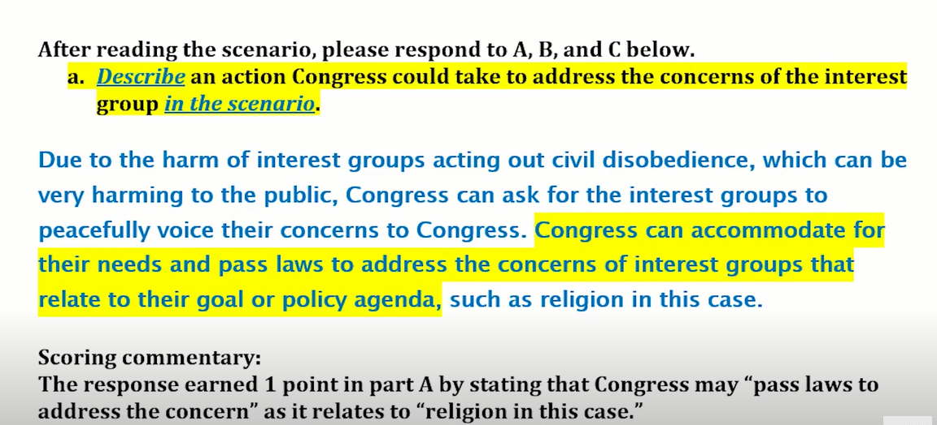
1st Section (A): 1 Point
No need for more than 2-3 sentences max.
DESCRIBE: Not just “identifying,” but describing an action IN THE SCENARIO
Whatever action description you give MUST be placed within the scenario and not generic like ” create a law.” Be specific!
Make sure your response addresses the entire prompt!
Worth 1 point - this response does not impact your ability to earn points on the other two sections
EXAMPLE:

Slide 26
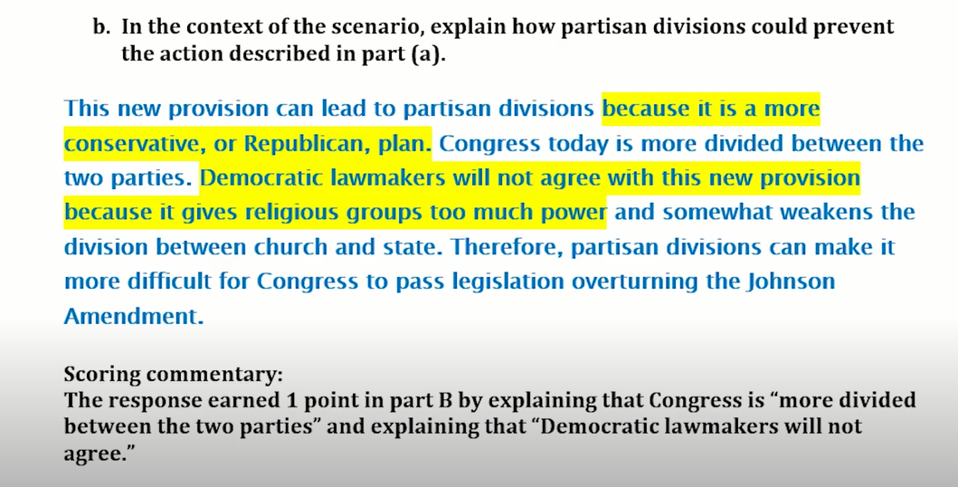
2nd Section (B)- 1 Point
Make sure your response addresses the entire prompt.
Explain - tell what it is, something about it, and why it is relevant to the discussion .
A good “Explain response” describes or defines any relevant terms in the prompt & explains by elaborating, providing evidence, giving an example in the context of the prompt. Also, “CLOSE THE LOOP” by restating the prompt in the context of the scenario
EXAMPLE

Slide 27
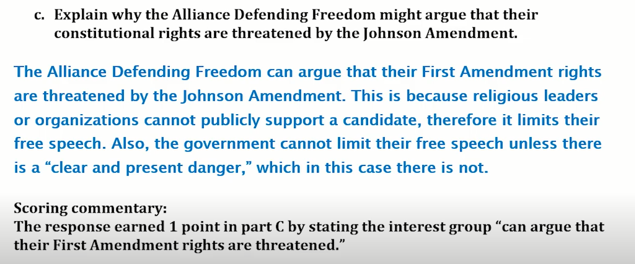
3rd Section (C): 1 Point
Make sure your response addresses the whole prompt.
Pay attention to the directions and the verbs used!
The Example below: This is clearly a free speech violation, but you have to EXPLAIN, not just identify the violation. The response below identifies the 1st amendment violation and EXPLAINS how the Johnson Amendment is violated the 1st amendment. It also explains what the Johnson amendment is. This earns the point.
EXAMPLE -

Slide 28
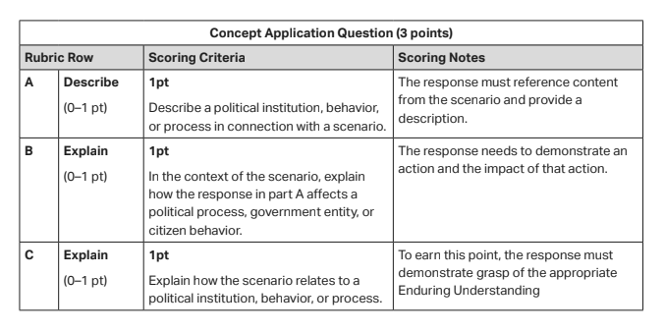
Conceptual FRQ Rubric
Point 1
Describe- define and connect to scenario
Be specific to that scenario (should make sense, cannot be just anything)
Point 2
Be specific to A (should make sense, cannot be just anything)
Point 3
Define process
Reference scenario (give example from scenario)

Slide 29
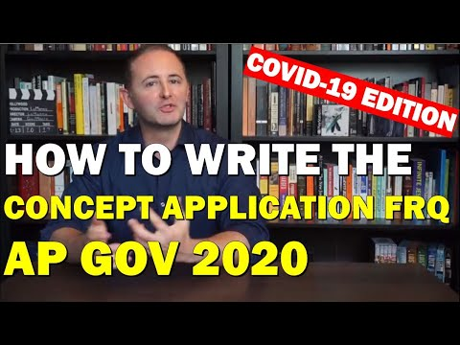

Slide 31
Conceptual Practice FRQ- Unit 1 & 2
We currently do not have a full understanding of the spectrum of illness from COVID-19, meaning we don’t know how often the disease will manifest as a mild, severe, or fatal disease. Since we haven’t yet been able to do surveillance testing in American communities or even of some patients in hospitals, mild and moderate cases are being missed. Even so, Dr. Anthony S. Fauci, head of the National Institute of Allergy and Infectious Diseases, recently suggested the COVID-19 may be 10 times as lethal as the flu, even for young, healthy individuals.
In her presentation, Dr. Alter emphasized that for reasons not yet understood, infection in certain patients, particularly the elderly and those with chronic medical conditions, can result rapidly and unpredictably in a severe lung inflammation called Acute Respiratory Distress Syndrome (ARDS), which can cause a cascade of organ and system failures.
New York Times
After reading the scenario, please respond to A, B, and C below.
A. Describe an action the President could take to address the problem described in the scenario, as well as the constitutional provision that would authorize that action.
B. In the context of the scenario, explain how the Constitution limits the President’s power to address this problem.
C. In the context of the scenario, explain how the principle of federalism affects the President’s ability to respond to the situation.

Slide 32
Conceptual Practice FRQ Unit 2
In May 2017 the Federal Communications Commission (FCC) announced a proposal to repeal net neutrality rules that govern how Internet service providers treat Internet traffic. Under net neutrality rules, companies that sell Internet services to customers must provide access to all Web sites at the same speed. Without net neutrality, Internet service companies can charge consumers or Web sites a premium for high-speed access to certain sites.
As required by statute, the FCC opened up the proposed rule for public comment. The rule received an astonishing 21 million comments. However, a study of the comments by Pew Research showed that only 6% of the comments were unique, suggesting that the comments were part of organized campaigns and possibly generated by computer bots. For example, on nine different occasions, more than 75,000 comments were submitted within the same second. Many of the commenter names and e-mail addresses also appeared to be fake.
Referencing the scenario, describe the function being carried out by the FCC.
Explain how interest groups can affect the process described in part A.
In December of 2017, the FCC created the rule ending net neutrality. Explain how Congress could respond to the decision made by the FCC if it opposes the new rule.

Slide 33
Conceptual Practice FRQ Unit 2
The following is from the 2016 Republican Party Platform. “Because the Federal Reserve’s monetary policy decisions affect job creation, upward mobility for workers, and equitable prosperity, they should be transparent. Similarly, the Federal Reserve’s important role as a lender of last resort should also be carried out in a more transparent manner. The Republican Party will advance legislation that brings transparency and accountability to the Federal Reserve, the Federal Open Market Committee, and the Federal Reserve’s dealing with foreign banks.”
https://www.gop.com/the-2016-republican-party-platform/
After reading the scenario, respond to A, B, and C below.
Describe an action, other than advancing legislation, that members of Congress may take to bring transparency and accountability to the Federal Reserve.
In the context of this section of the Republican Party platform, explain how the proposal to increase transparency and accountability described in part A would affect the Federal Reserve’s ability to make economic policy.
Explain how ideological differences between the parties might affect Democratic Party support of the propos

Slide 34
Conceptual Practice FRQ Unit 2
he Securities and Exchange Commission (SEC) today charged Elon Musk, CEO and Chairman of Silicon Valley-based Tesla Inc., with securities fraud for a series of false and misleading tweets about a potential transaction to take Tesla private.
On August 7, 2018, Musk tweeted to his 22 million Twitter followers that he could take Tesla private at $420 per share, that funding for the transaction had been secured, and that the only remaining uncertainty was a shareholder vote. The SEC’s complaint alleges that, in truth, Musk had not discussed specific deal terms with any potential financing partners, and he allegedly knew that the potential transaction was uncertain. . . . According to the SEC’s complaint, Musk’s tweets caused Tesla’s stock price to jump by over six percent on August 7, and led to significant market disruption. "Corporate officers hold positions of trust in our markets and have important responsibilities to shareholders," said Steven Peikin, Co-Director of the SEC’s Enforcement Division. "An officer’s celebrity status or reputation as a technological innovator does not give license to take those responsibilities lightly."
"Taking care to provide truthful and accurate information is among a CEO’s most critical obligations," added Stephanie Avakian, Co-Director of the SEC’s Enforcement Division. "That standard applies with equal force when the communications are made via social media or another non-traditional form."
Source: SEC Press Release, "Elon Musk Charged With Securities Fraud for Misleading Tweets," September 27, 2018
After reading the scenario, please respond to A, B, and C below.
Describe the role of the Securities and Exchange Commission (SEC) in the context of the scenario.
Explain how Congress can affect how the SEC acts in the role described in part A.
Suppose there is a vacant seat on the Securities and Exchange Commission and the issue in the scenario is still pending. In the context of the scenario, explain how the process of selecting a new commissioner illustrates oversight and accountability in the bureaucracy.

Slide 35
Conceptual Practice FRQ - Unit 1 & 3
On October 26, 2001, the 342-page USA PATRIOT ACT quickly passed through Congress and was signed into law just 45 days after 9/11. It expanded the federal government’s ability to access phone and e-mail communications to an unprecedented level. It gave the FBI the authority to obtain personal information on people suspected of terror-related activities without the approval of judges.
Broad support for these additional security measures led to this quick response by Congress and the president, but it also ignited a long-standing debate in American government regarding the balance between civil liberties and social order. Groups such as the American Civil Liberties Union launched campaigns opposing the measures and cautioning against the erosion of civil liberties in the wake of the 9/11 attack.
A. Describe a section of the Constitution that a group such as the American Civil Liberties Union would likely say is most affected by the USA PATRIOT ACT.
B. Explain how checks and balances could work to ensure that the section of the Constitution identified in Part A would be protected.
C. Over time, some of the measures of the USA PATRIOT ACT have been challenged by state governments who do not wish to cooperate with the federal government. Explain a concept of American government and politics that this action illustrates.

Slide 36
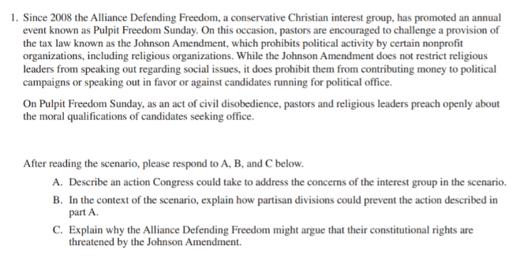
Conceptual Practice FRQ Unit 3

Slide 37
Conceptual Practice FRQ- Unit 3
Today, Stephanie Schriock, president of EMILY’s List, the nation’s largest resource for women in politics, released the following statement recognizing Equal Pay Day:
“It’s unacceptable that it takes almost 100 additional days for a woman working full time to make as much as a man working full time in 2018. Unfortunately, Republicans in Congress and legislatures across the country would rather attack women’s rights than support policies that fight to end gender discrimination in pay.
“Every day, women feel the burden of the gender pay gap as they work to take care of their families — and for women of color the burden is even greater. America’s women and families deserve representatives who will fight to expand their economic opportunity and finally put an end to gender-based wage discrimination. That’s why EMILY’s List is proud of our pro-choice Democratic women in the House who helped pass the Paycheck Fairness Act just last week. The GOP has made clear how little they value the work of women, but EMILY’s List will continue working to elect women around the country who recognize the value of equal pay for equal work.”
Source "EMILY’s List Recognizes Equal Pay Day", Emily's List, Washington D.C., April 2nd, 2019
After reading the scenario, respond to A, B, and C below:
(A) Describe an action being taken by Emily's List in the scenario
(B) Explain how the action described in Part A affects policy making in Congress
(C) Explain how the constitutional protection of speech supports this scenario

